Slide 1
Amazon Sales Data Analysis
Amazon is one of the leading E-commerce platform where
users can buy millions of products from a lot of categories.

Slide 2
Objectives:
To calculate total sales, total profit, average profit margin and average unit price
• To find which order priority gave highest sales
• To find which is the bestseller Item type
• To find which mode of channel generated maximum sales
• To find yearly total sales
• To find total sales and total profit by region
• To find the number of units sold of a particular item type

Slide 3

Data Analysis:

Slide 4
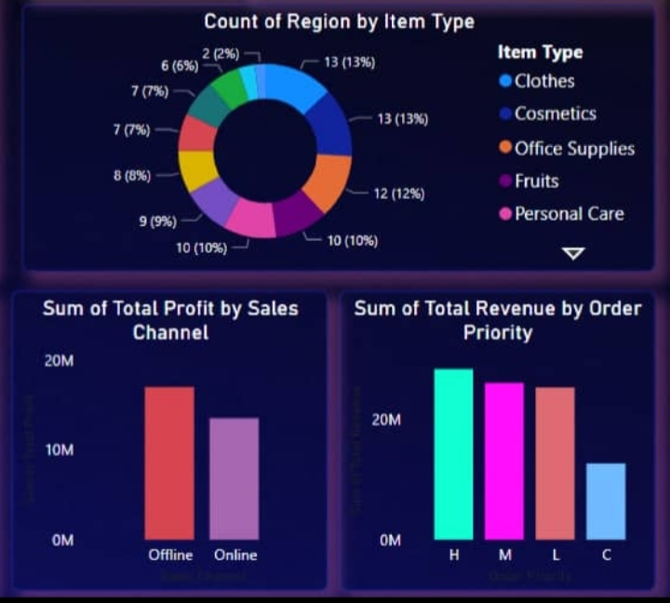

Slide 5
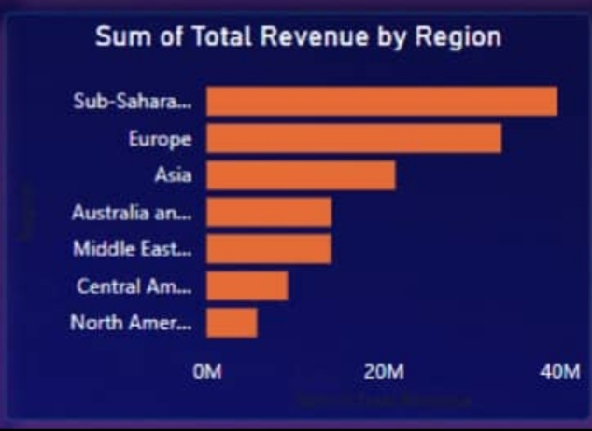

Slide 6
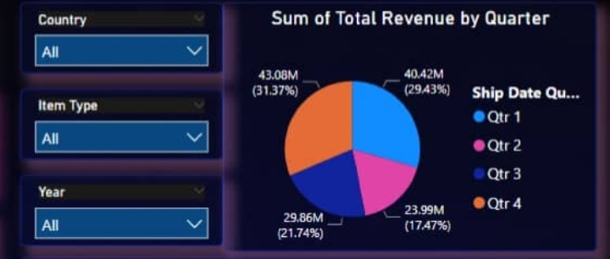

Slide 7
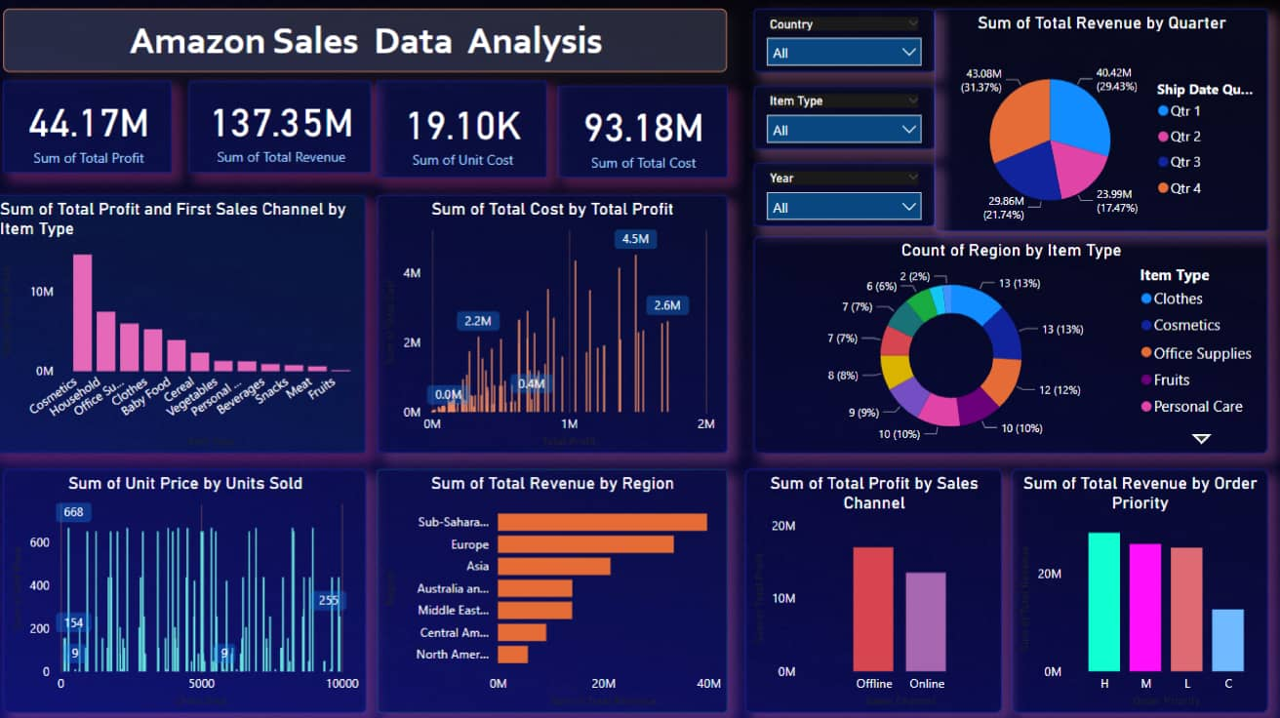

Slide 8
Insights:
The total sales is $137.35 million out of which total profit is $44.17 million. • The average profit margin and unit price is $32.16 and $276.76 respectively. • The “H” order priority gave the highest sales, which means people need their products fast. • “Cosmetics” products gave the highest sales. • Majority of people still prefer “Offline Channel” for buying products. • The year 2012 has seen the highest sales • The Sub-Saharan Africa region has seen the highest sales

